Slide 1


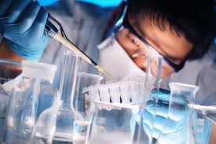

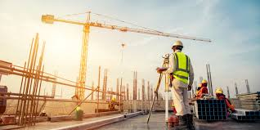

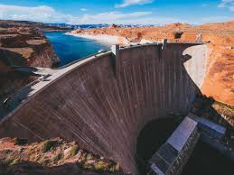


DJILLALI LIABES UNIVERSITY OF SIDI BEL-ABBES
Faculty of Technology
Bachelor's degree
2nd year
of license (L2)
Courses offered :
1- Aeronautics
2- Civil engineering
3- Mechanical Engineering
4- Process Engineering
5- Hydraulic
6- Public works
Specialties
3rd year of license (L3)
Mechanical Engineering
1- Energetics
2- Mechanical construction
3- Materials Engineering
&
Aeronautics
1- Aeronautics
Civil Engineering
1- Civil Engineering
&
Public Works
1- Public Works
Ranking and
orientation
1st year
of licence (L1)
Common ground ST
Process engineering
1- Process engineering
Hydraulics
1- Hydraulics
+ Bac
Department of Basic Education in Science & Technology
Department of Mechanical Engineering
Department of Civil Engineering and Public Works
Department of Energy and Process Engineering
Department of Hydraulics

Slide 2

Master's degree
DJILLALI LIABES UNIVERSITY OF SIDI BEL-ABBES
Faculty of Technology
Mechanical Engineering
1. Energetics
2. Renewable energies in mechanics
3. Mechanical construction
4. Materials Engineering
5. Mechanical and production manufacturing
&
Aeronautics
Aeronautical structures
Master 2
Civil Engineering
Metallic and mixed construction
Geotech
Materials in civil engineering
Structures
&
Public Works
Tracks
structures
Master 1
Energy and Process Engineering
1. Chemical engineering
2. Environment processes engineering
Hydraulics
Urbans Hydraulics
Hydraulic works
Ranking and
orientation
+ Bachelor's degree
Department
of Mechanical Engineering
Department of Civil Engineering and Public Works
Department of Energy and Process Engineering
Department
of
Hydraulics

Slide 3


DJILLALI LIABES UNIVERSITY OF SIDI BEL-ABBES
Faculty of Technology
Doctoral degree
Mechanical Engineering
Useful doctoral training in the service of development
Civil engineering and public works
Doctor
Accredited research laboratories
1- Materials & Hydrology - LM&H
2- Materials and reactive systems - LMSR
3- Mechanics and physics of materials - LMPM
4- Civil and Environmental Engineering - LGCE
5- Mechanics of structures and solids - LMSS
6- Advanced Structures and Materials in Engineering Civil and Public Works – LSMAGCTP
7- Process, materials and environment engineering laboratory – LGPME
National access competition
Process engineering
Hydraulic
OPPORTUNITIES
Advanced training abroad
Residential training abroad
Doctorate in joint supervision
Participation in national and international congresses
Educational experience
+ Master

Slide 4
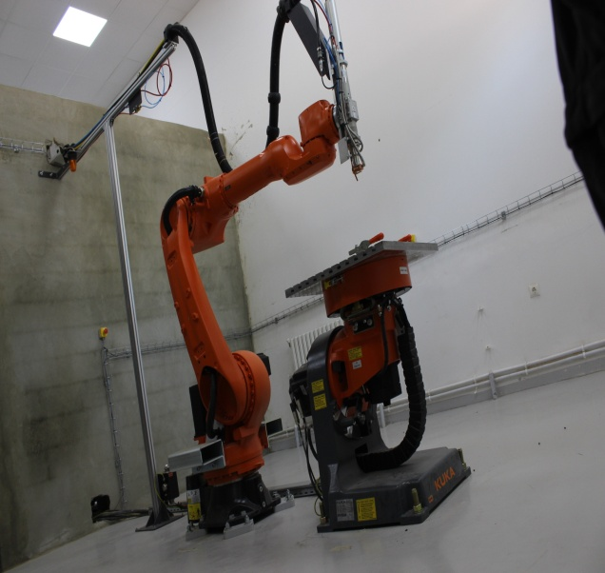
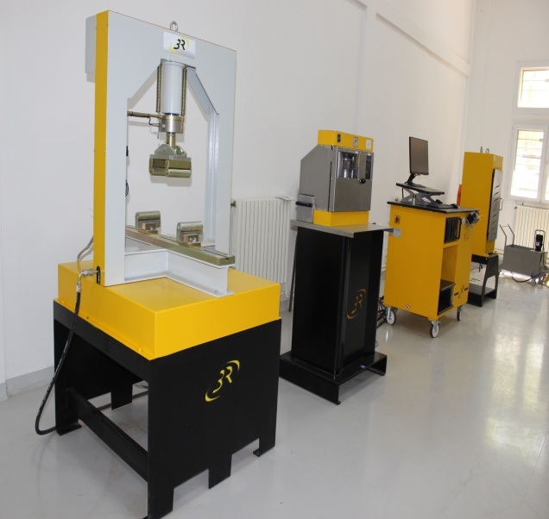
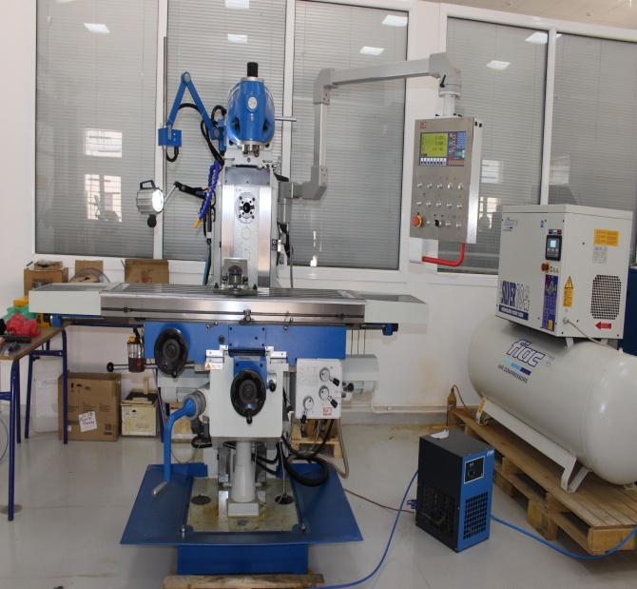
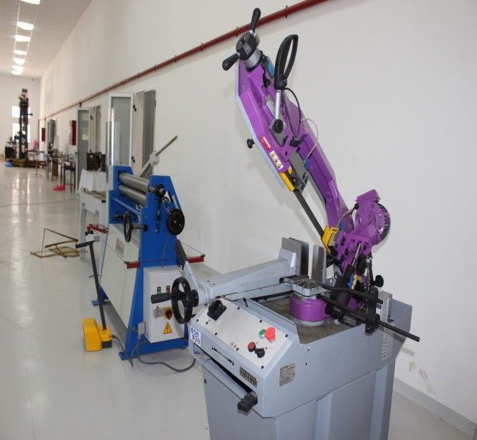
Practical work and internships in a professional environment

